Slide 1

Mercedes Benz price prediction

Slide 2
Business Objectives
The Mercedes-Benz company aims to empower junior salespeople with an advanced pricing tool to enhance their decision-making capabilities.
The primary objective is to develop a predictive model that accurately estimates the prices of used Mercedes-Benz cars.

Slide 3
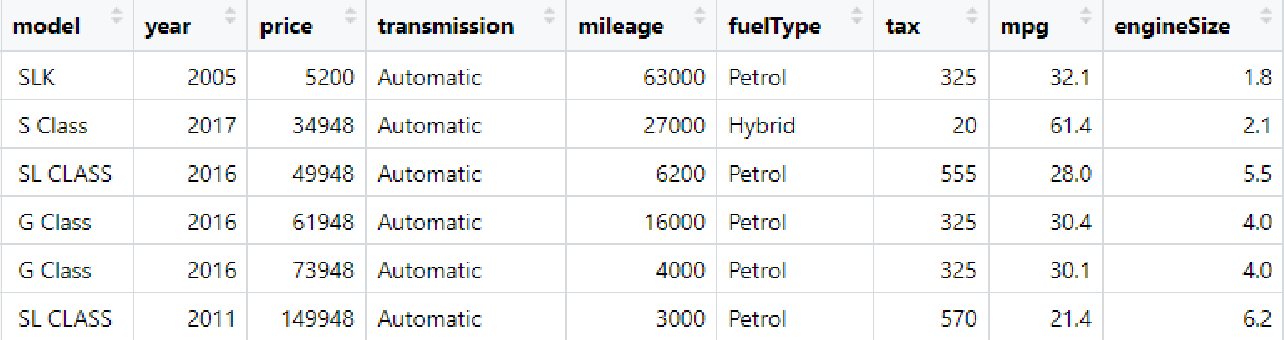
Dataset
Data from Kaggle the price range of listed Mercedes Used Car.
The model year ranges between 1970-2020.

Slide 4
PROCESS
1. Explore data
2. Data preparation
3. Model training
4. Model evaluation
5. Conclusion and recommendations

Slide 5
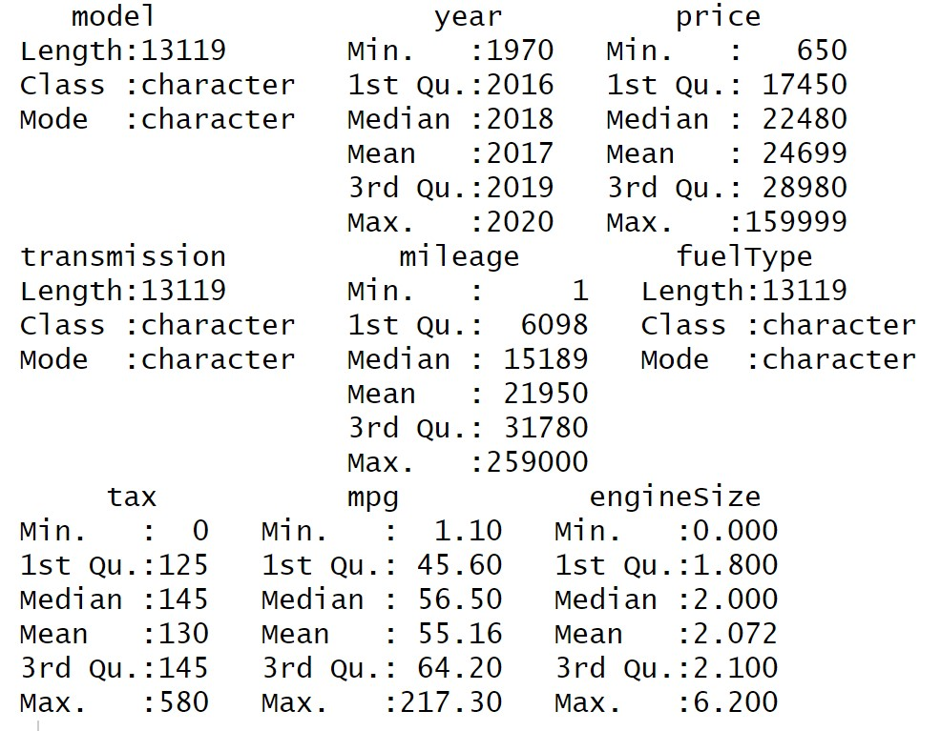
Data Exploration
The dataset is clean
13119 rows, 9 columns & 27 Mercedes-Benz models

Slide 6
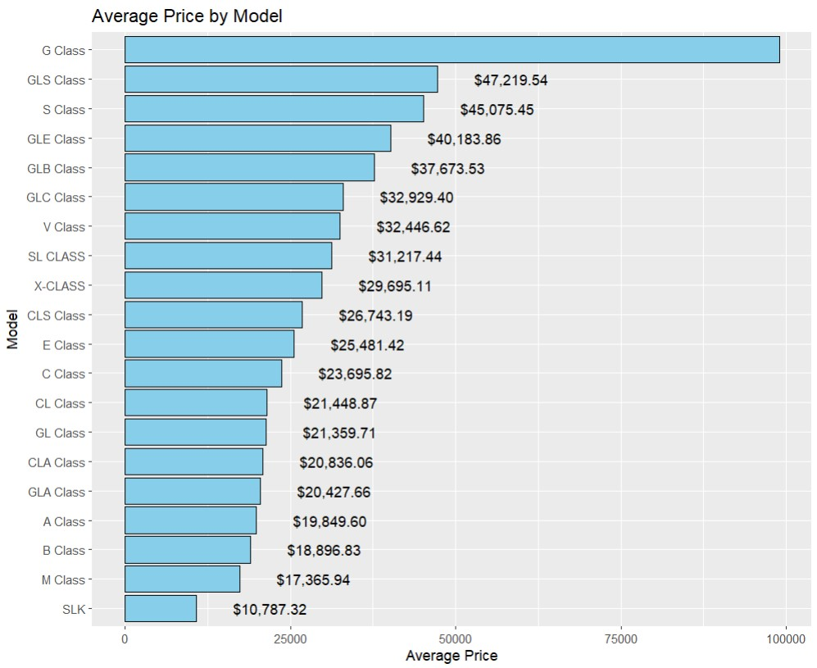
Average Price by Model
The model with the highest average price is G Class, $98934
and The model with the lowest average price is CLK, $3078.

Slide 7
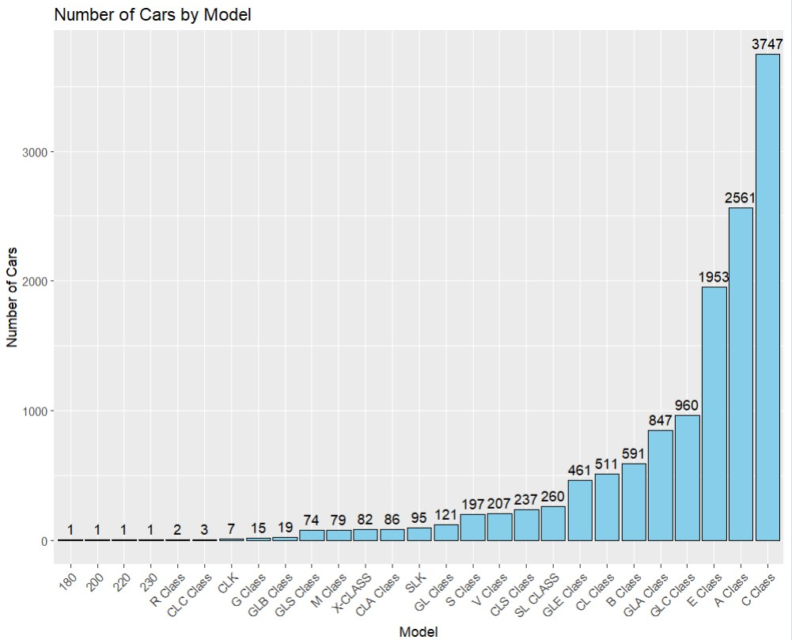
Number of Cars by Model
C Class, A Class and E Class are popular models with 63% of the samples in this dataset

Slide 8
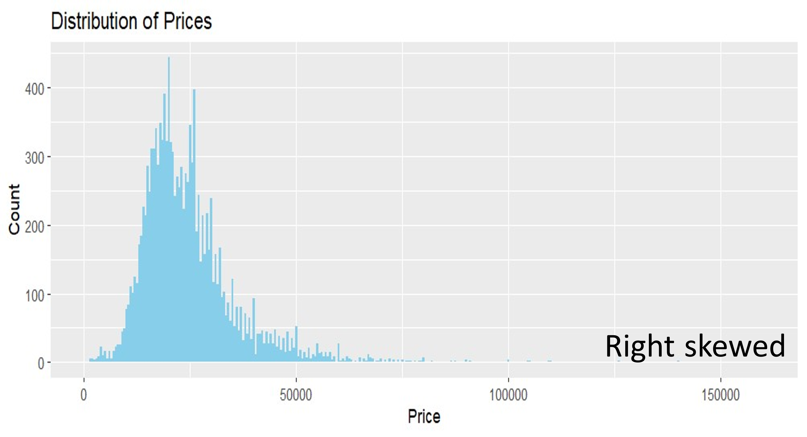
Distribution of Prices

Slide 9
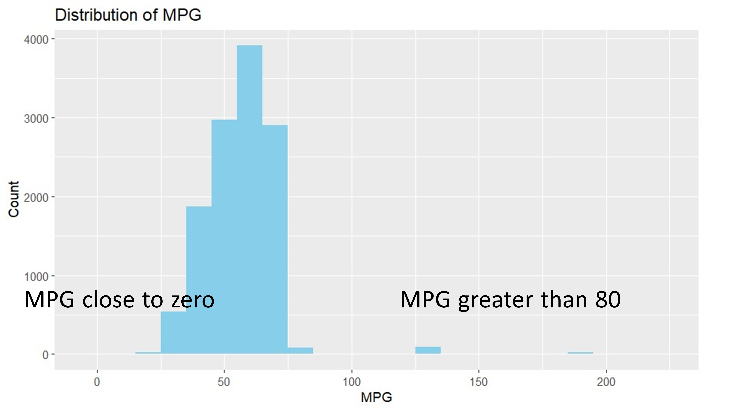
Distribution of MPG

Slide 10
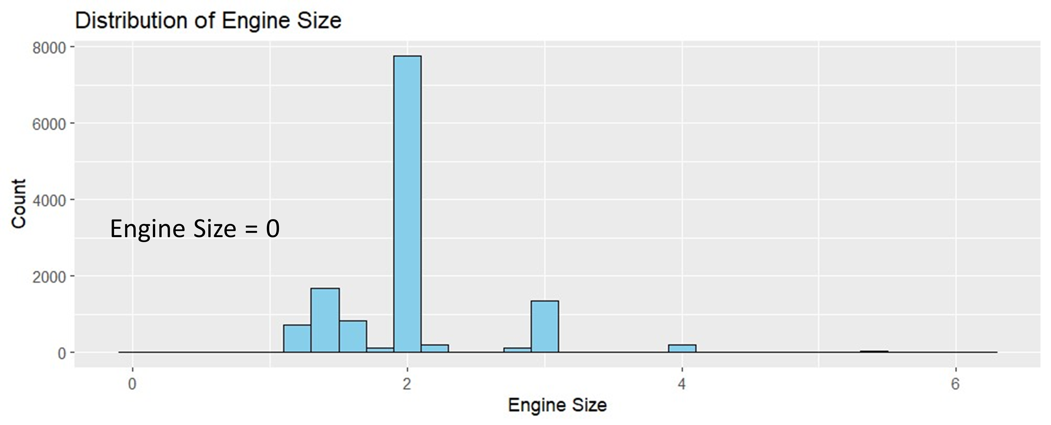
Distribution of Engine Size

Slide 11
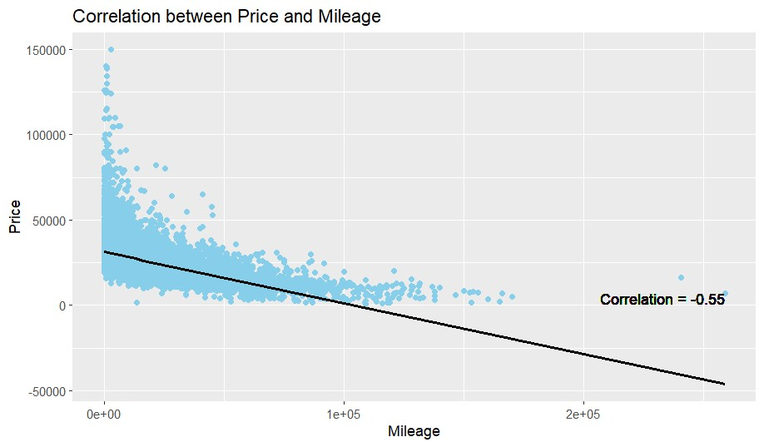
Correlation price and mileage
Negative Correlation

Slide 12
Data Preparation
Convert variables to the right types
Filter out models with a sample size of less than 50
Filter out cars with engine size = 0
Identify and handle outliers

Slide 13
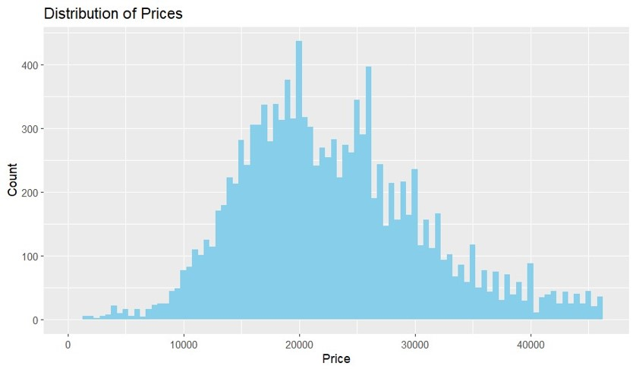
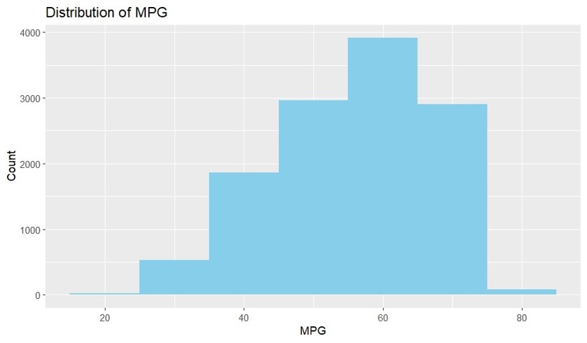
Data Preparation
Distribution became quite normal after outliers were removed

Slide 14
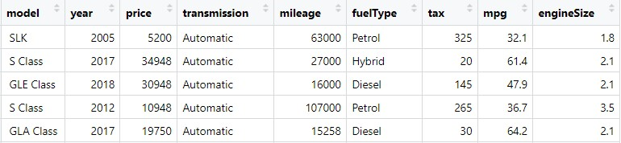
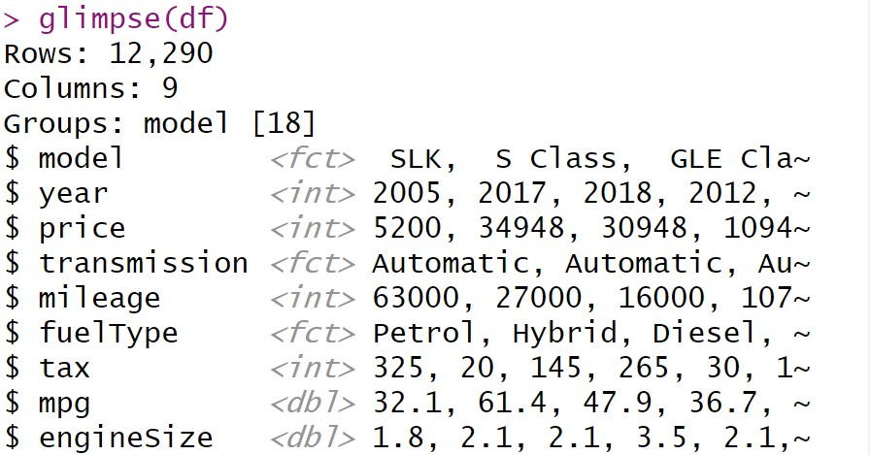
Final Dataset
Final clean dataset is ready for model training 12,290 rows & 9 columns Data types are in the correct format.

Slide 15
Model Training
1. Train test split (80: 20)
2. Model training
i. Linear regression as a baseline model
ii. Random forest
3. Scoring
4. Model evaluation

Slide 16
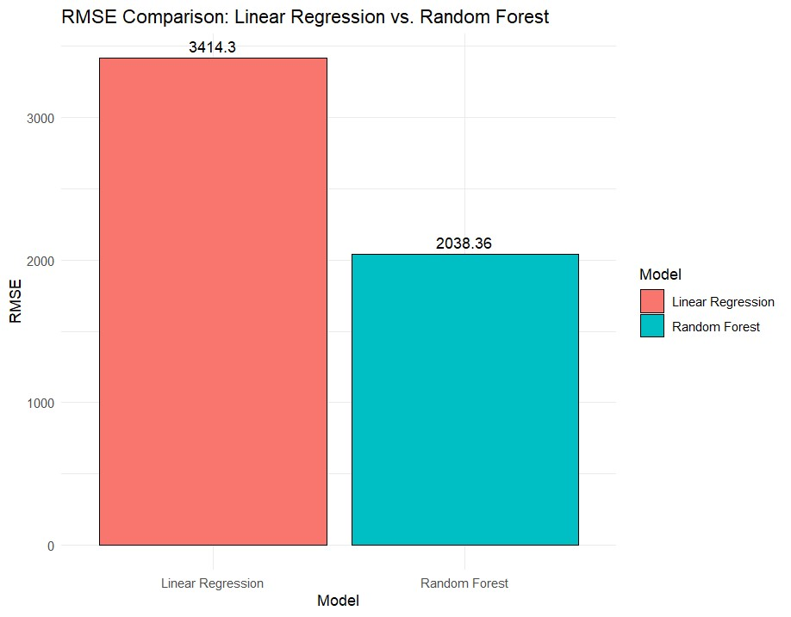
Model Evaluation
Random Forest outperforms Linear Regression with lower RMSE.

Slide 17
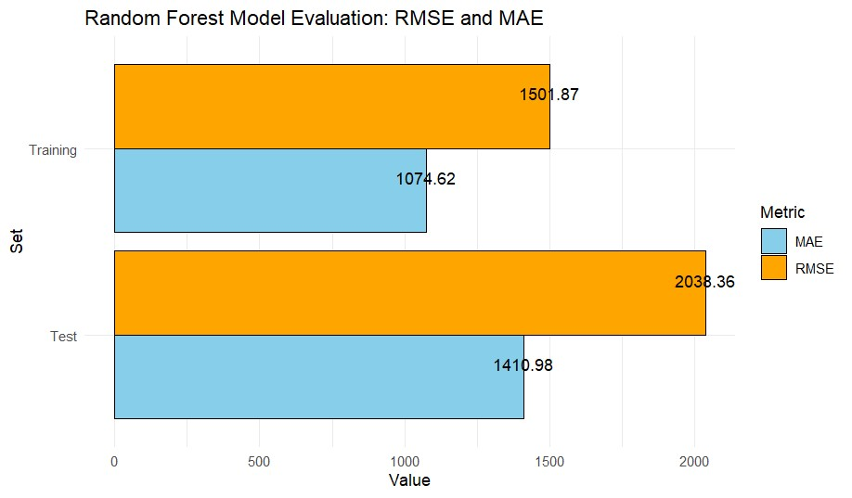
Model Evaluation
The model performed well with lower RMSE and MAE.

Slide 18
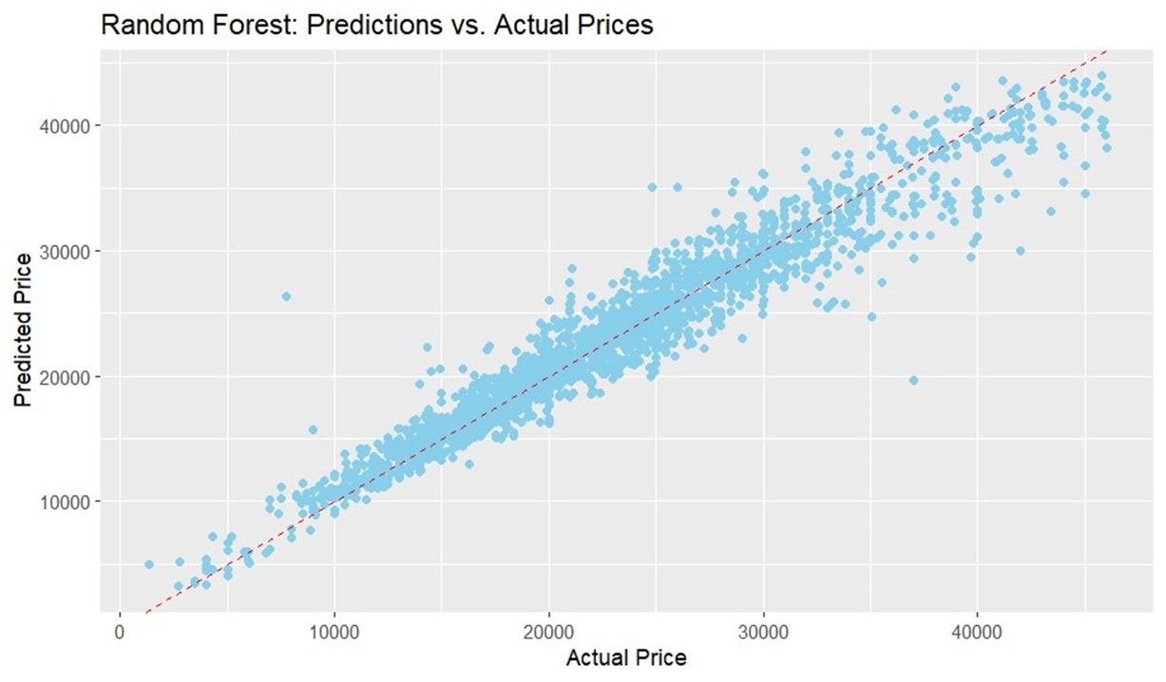
Good Results

Slide 19
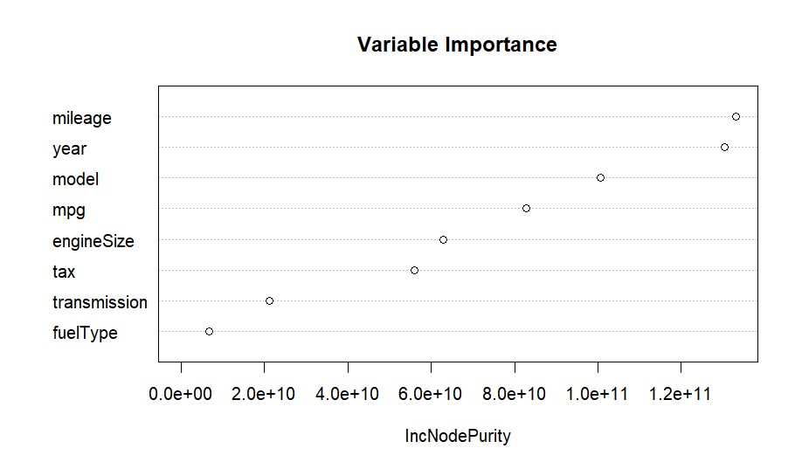
Variable Importance
Mileage is the highest important feature.

Slide 20
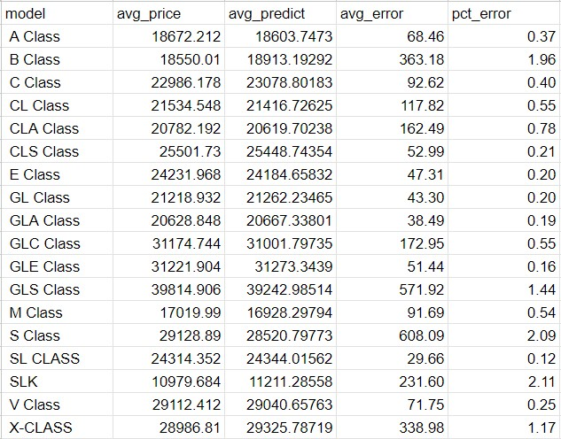
Error by Models
Average % error for most models are under 5% absolute error on average less than $700

Slide 21
Recommendations
Collect more data
Try different algorithms
Hyperparameter tuning

Slide 22

THANK YOU

